Slide 1
CSCI 4360/6360 Workshop Baysian ML with EdWard
Hao Yang
Jialin Yang

Slide 2
Overview
Introduction to Bayesian Learning
Brief Overview of Edward
Coding example with Edward

Slide 3

Introduction to Bayesian Learning

Slide 4
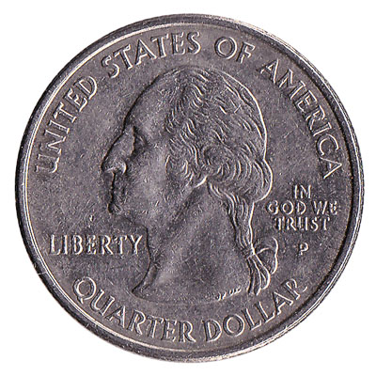
Introduction to Bayesian Learning
What is the frequentist method?

Slide 5
Introduction to Bayesian Learning
How confident are of p being 0.6?
How confident are of p being 0.55?
Which of these values is the accurate estimation of p?
Will p continue to change when we further increase the number of coin flip trails?

Slide 6
Introduction to Bayesian Learning
Case 1: observing 5 heads and 5 tails.
Case 2: observing h heads and 10-h tails.

Slide 7
Introduction to Bayesian Learning
P(parameters, data) = P(parameters) × P(data|parameters)
Parameters: fairness of the coin
Data: coin tosses
P(parameters): prior probability of a certain fairness
P(data|parameters): conditional probability that the data is observed given that the coin has a certain fairness
P(parameters, data): joint probability that both the data is observed and the coin has a certain fairness

Slide 8
Edward

Slide 9

Edward
It supports modeling with
Directed graphical models
Neural networks
Implicit generative models
Bayesian nonparametrics and probabilistic programs

Slide 10
Edward
It supports inference with
Variational inference
Monte Carlo
Compositions of inference
Edward is built on TensorFlow. It enables features such as computational graphs, distributed training, CPU/GPU integration, automatic differentiation, and visualization with TensorBoard.

Slide 11
Bayesian Learning

Slide 12
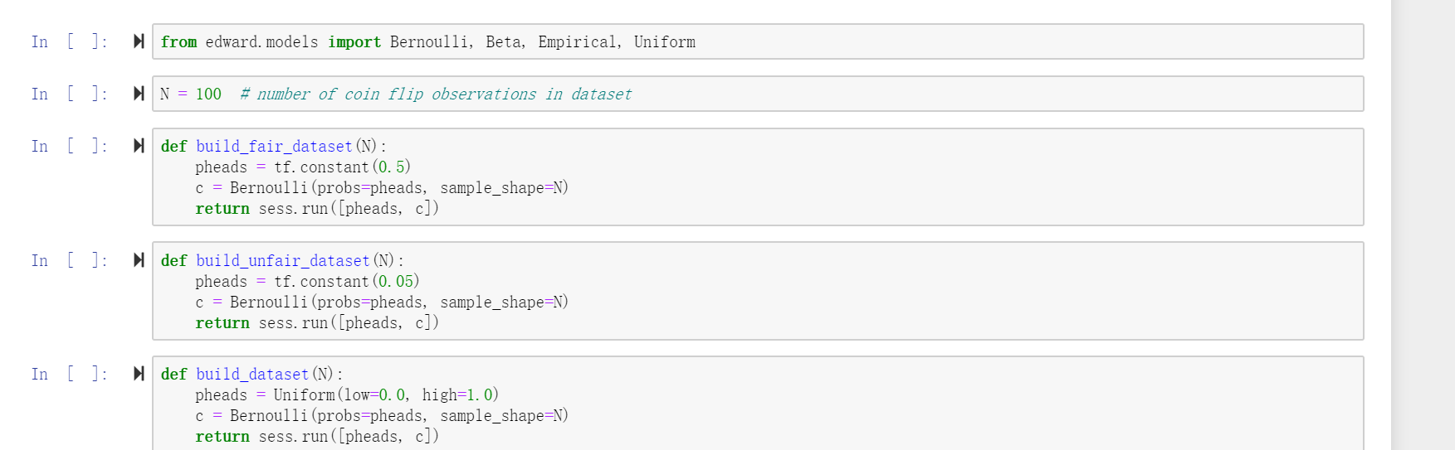
Bayesian Learning

Slide 13
Bayesian Learning
>>> pheads = Uniform(low=0.0, high=1.0) # parameters: fairness of the coin
>>> c = Bernoulli(probs=pheads, sample_shape=N)) # data: coin toss
>>> sess.run([pheads, c])
Uniform: prior probability of the fairness. Uniform stands for complete uncertainty with respect to the fairness
Bernoulli: conditional probability that the data is observed given a certain pheads. Bernoulli models a toss of a coin with fairness probability.
sess.run: sample from the joint probability of the coin fairness and the coin tosses.

Slide 14
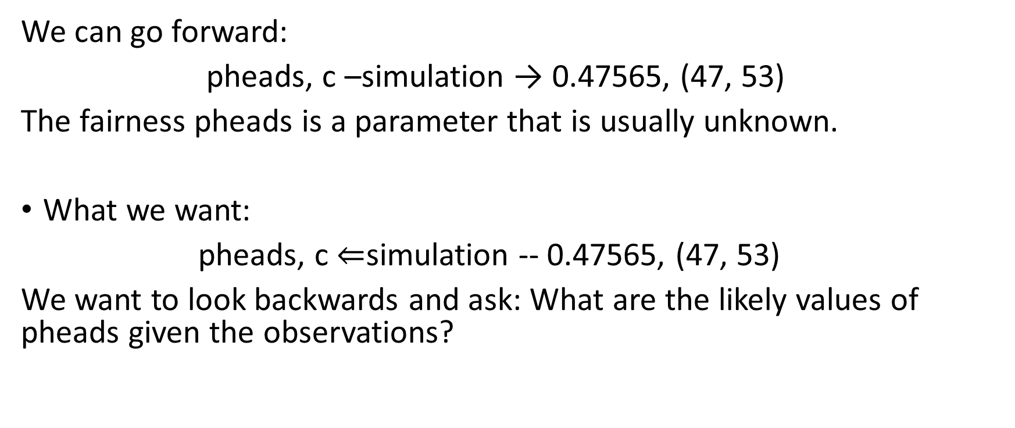
Bayesian Learning
We can go forward:
pheads, c –simulation → 0.47565, (47, 53)
The fairness pheads is a parameter that is usually unknown.
What we want:
pheads, c $⇐$simulation -- 0.47565, (47, 53)
We want to look backwards and ask: What are the likely values of pheads given the observations?

Slide 15
Baysian Inference

Slide 16

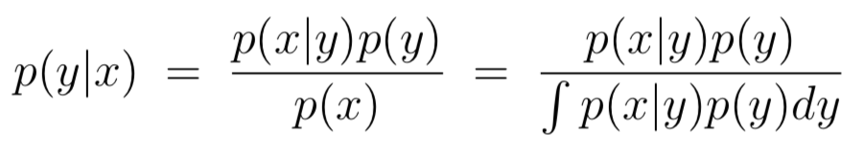
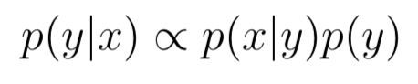
Inference-Backward Selection
Bayes Rule:
y: priori; x is p(x|y), which is from data-generating distribution.
Purpose: learn p(y|x) after considering new evidence (data).
Proplems:
1. p(x|y) can be complicated
2. p(y|x) may not have closed-form solution
Two issues:
1. Define models for data-generating phenomenon.
2. Define inference algorithms for learning the posterior distribution p(y|x).
Choose the most likely distribution for parameters, which makes the data most likely to be observed.

Slide 17
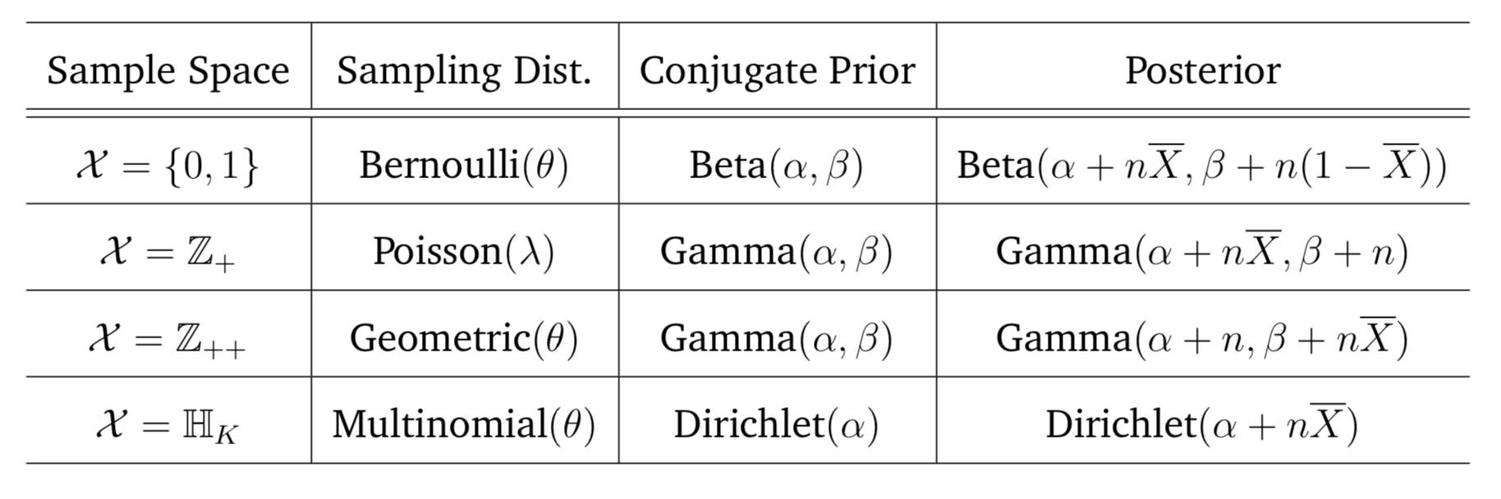
Data-generating distribution
Beta-Bernoulli model
Sample is Bernoulli(p), we propose the prior/posterior distribution be Beta.

Slide 18
Coin Example:
>>> pheads = Uniform(low=0.0, high=1.0) # params: fairness of the coin
>>> c = Bernoulli(probs=pheads, sample_shape=100) # data: coin tosses
>>> pheads_cond = ed.complete_conditional(pheads) # derive the posterior p(params∣data)
>>> pheads_post = ed.copy(pheads_cond, {c: c_train}). # bind the posterior to the observations
>>> sess.run({key: val for
... key, val in six.iteritems(pheads_post.parameters)
... if isinstance(val, tf.Tensor)})
{'concentration0': 51.0, 'concentration1': 51.0}

Slide 19
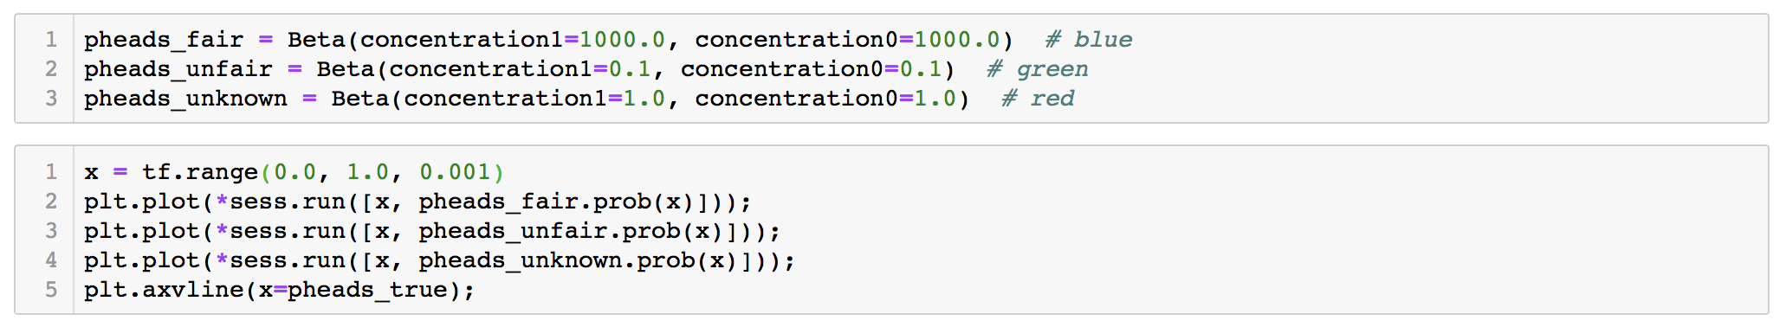
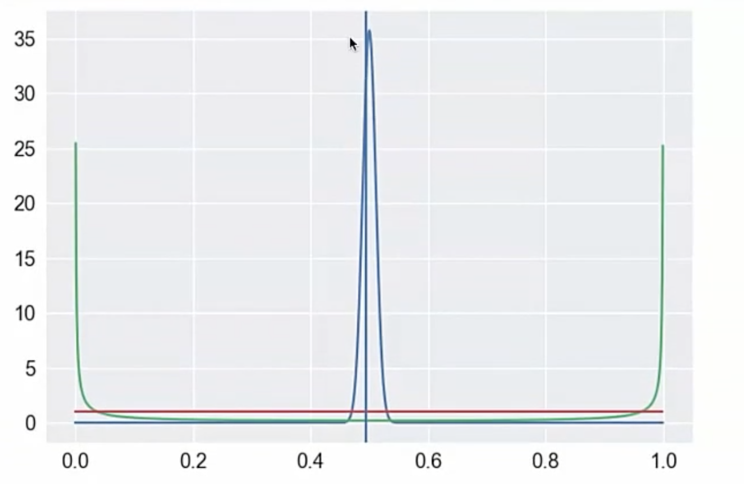
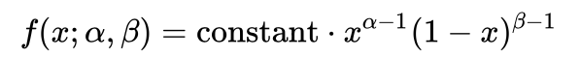
Why we choose Beta distribution?

Slide 20
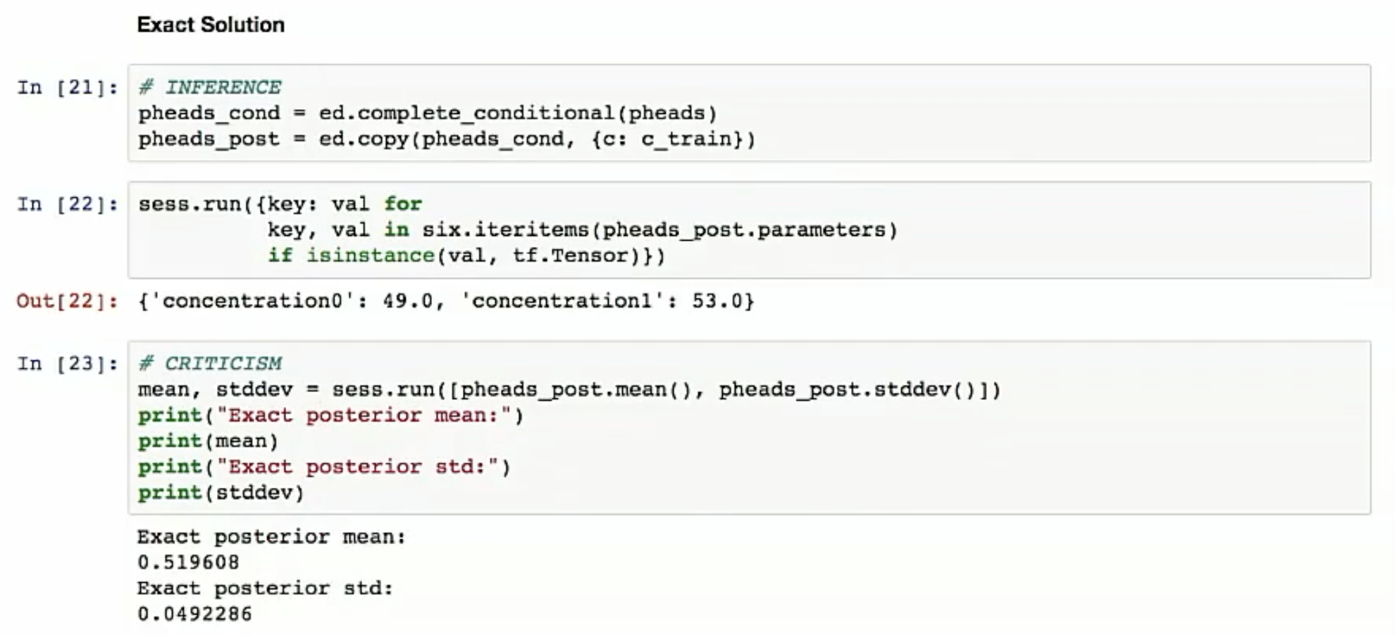
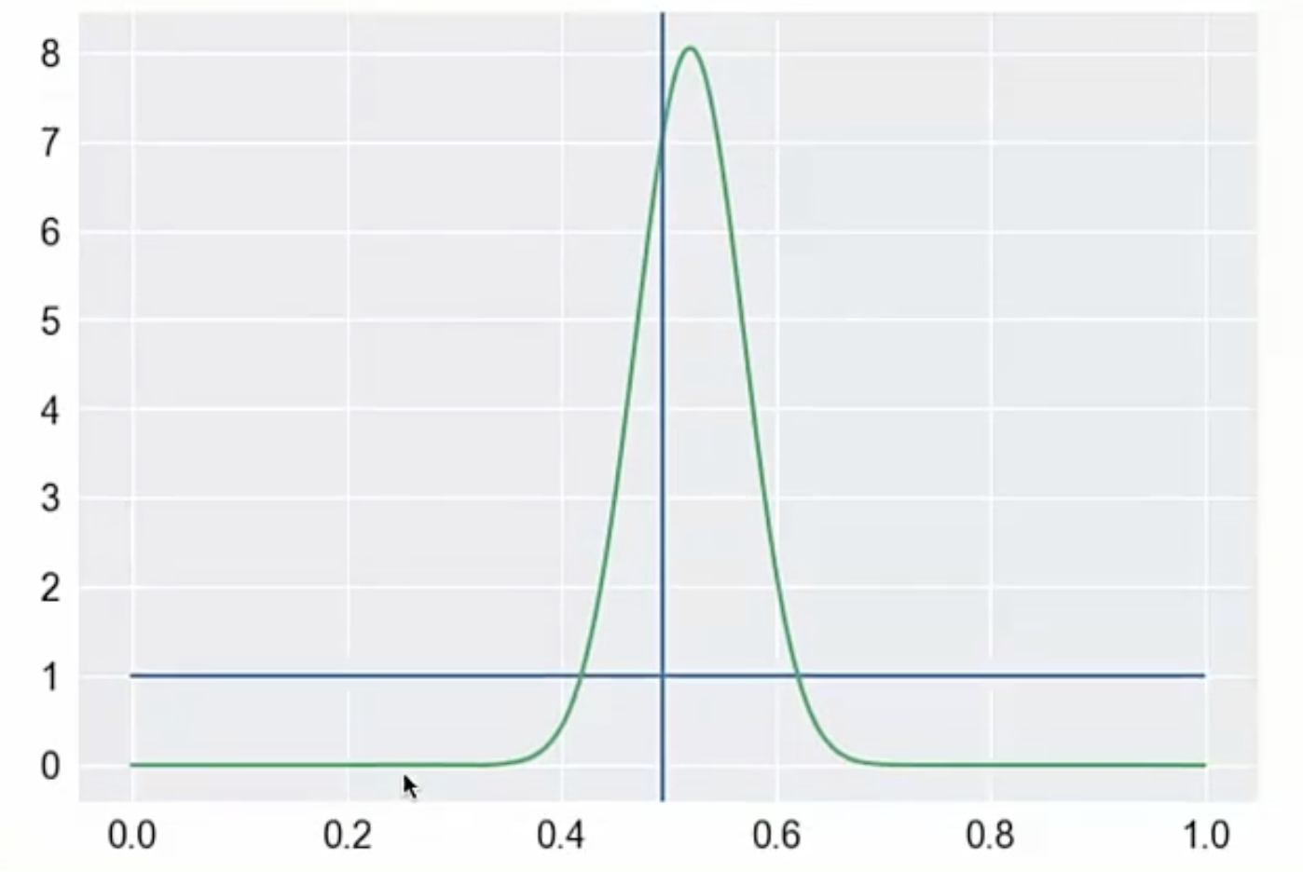
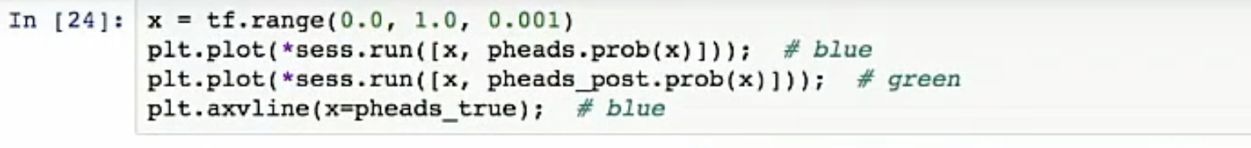
Exact Solution-simple example

Slide 21
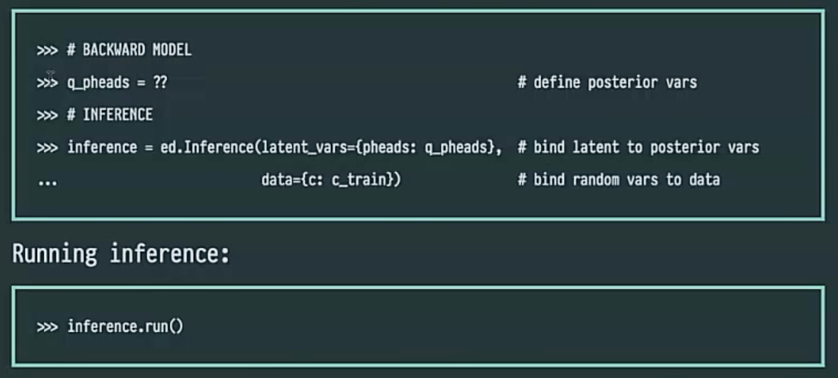
Two Popular Inference Algorithms
Markov Chain Monte Carlo
Variational Inference

Slide 22
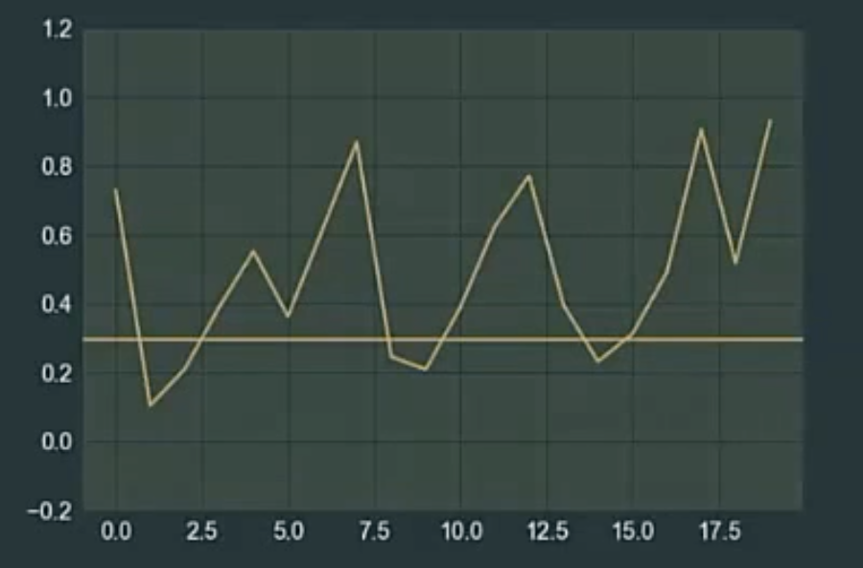
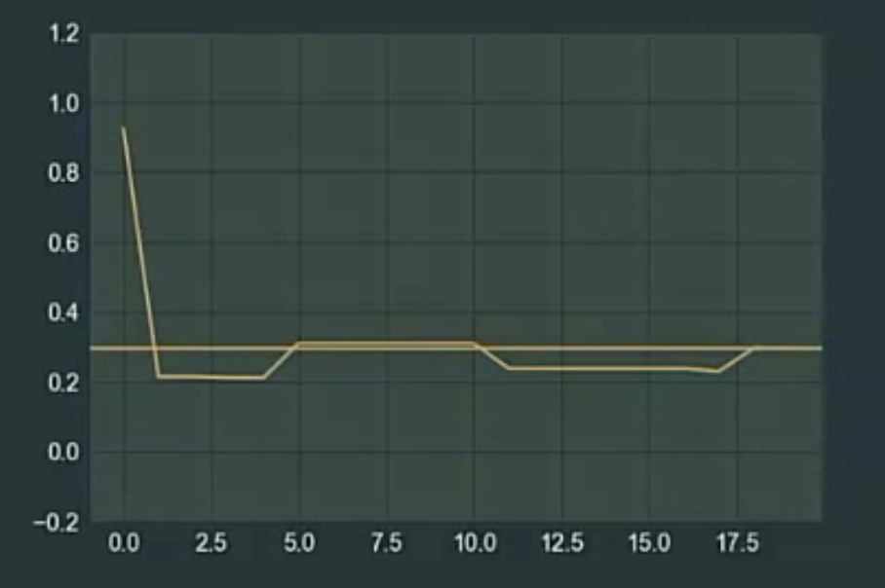
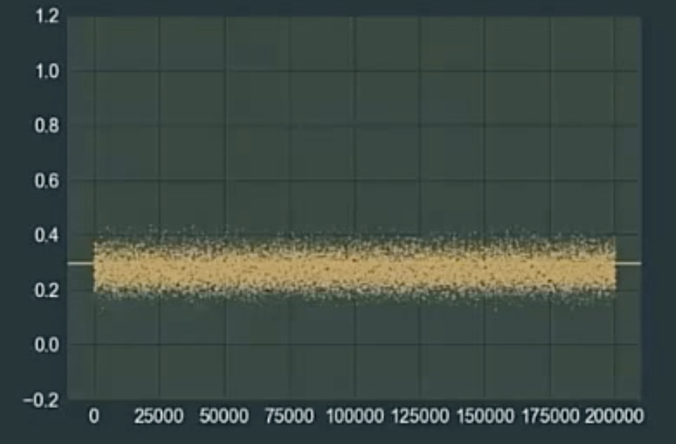
Markov Chain Monte Carlo

Slide 23
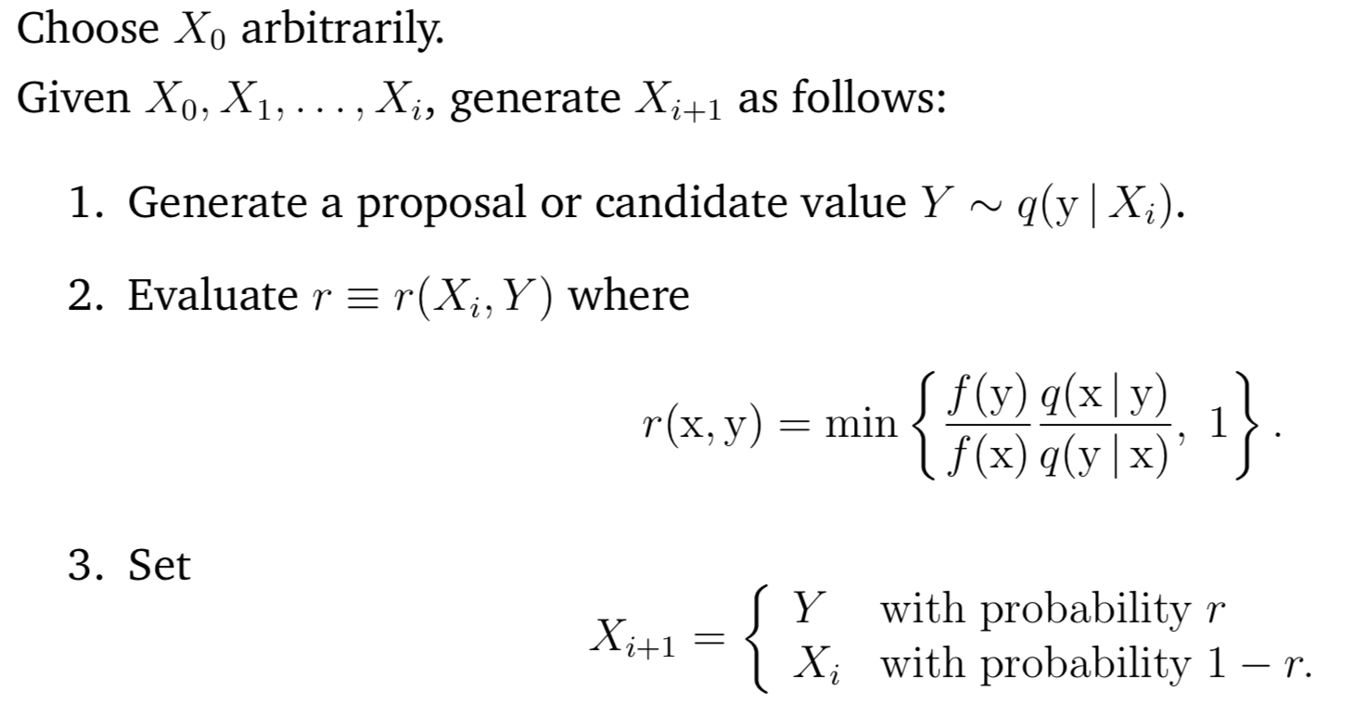
MCMC-Metropolis-Hasting Algorithm
MCMC is a class of randomized algorithms that approximate the posterior, p(params|data=obs)
A Markov Chain is an infinite stream of parameter values generated by appying a random function repeatedly.

Slide 24
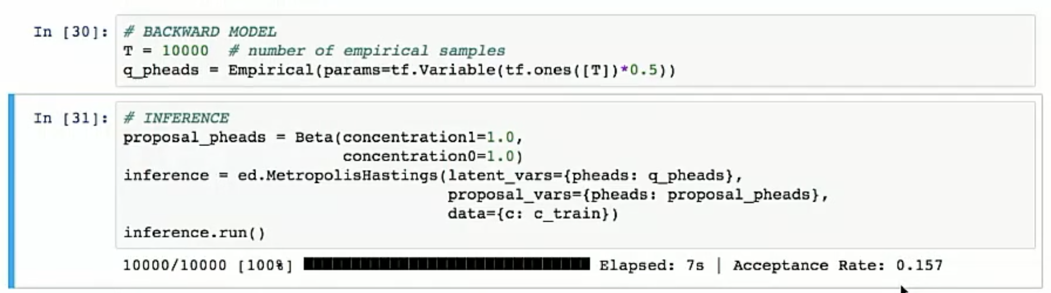
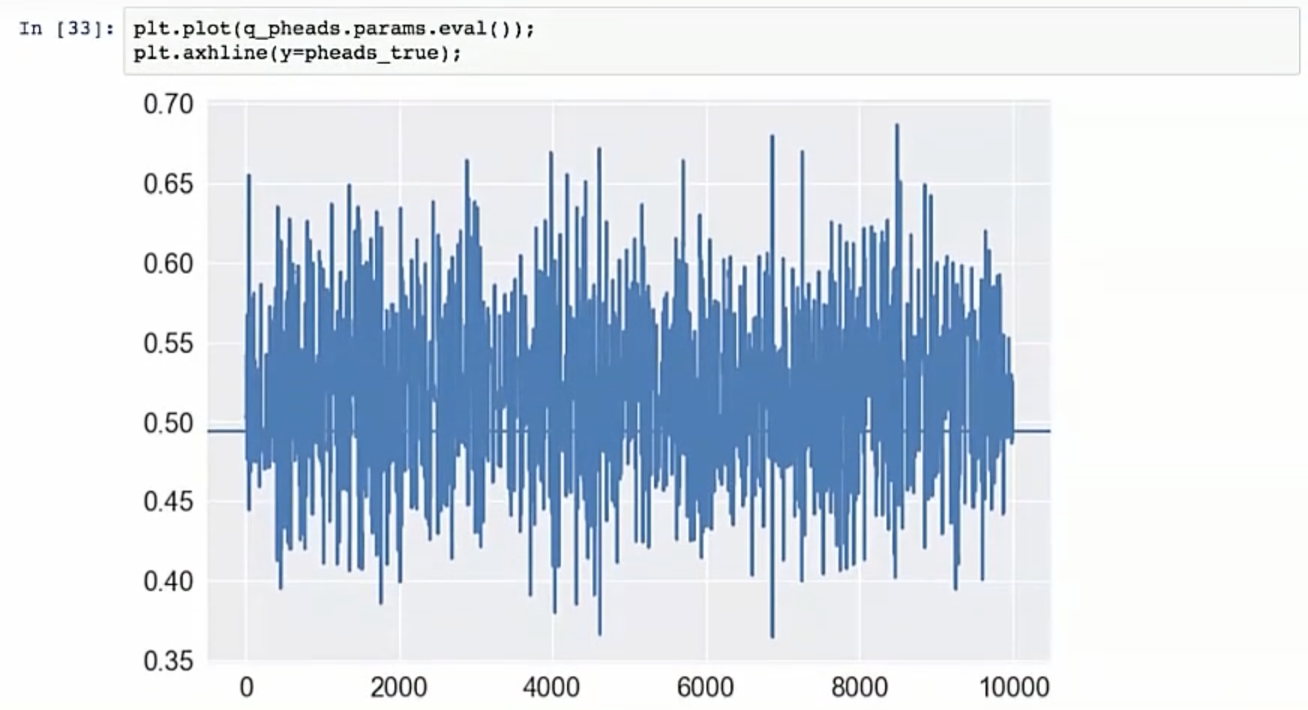
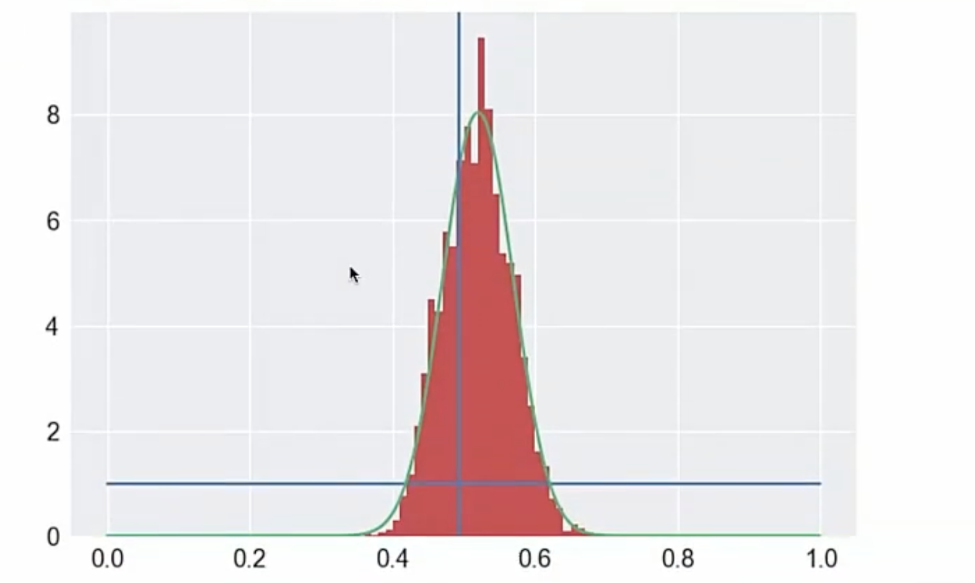
MCMC-Metropolis-Hasting Algorithm

Slide 25
Reference
1. http://www.columbia.edu/~jwp2128/Teaching/E6720/BayesianModelsMachineLearning2016.pdf
2. http://www.stat.cmu.edu/~larry/=sml/Bayes.pdf
3. https://github.com/UnataInc/PyCon2017/tree/0e147cef11571d02cfe8c0319b5c9cf862de11b2

Slide 26

Thanks!

